Slide 1
Protege Nos
Yiluo Li, Shaolin Zhang, Thomas Lee, Yong Mao

Slide 2
AI ==

Slide 3
From where
A friend of mine is a volunteer for a disabled-student community, and we feel that their lives are not easy, so we intend to make a little contribution to the improvement of the lives of these underrepresented group.
did we get the idea

Slide 4
Technological Implementation

Slide 5
Ruff
Light Sensor
Determine if the environment is dark
LED
To remind others that there is a blind man here
Temperature & Humidity Sensor
Feedback real-time temperature and humidity
A JavaScript-based IoT Kit

Slide 6
Arduino
Tracking module
To detect whether or not the traveling route is offset
Avoid module
To detect obstacles
Gyro module
When the user falls, immediately send relevant information to the volunteer network
A C-powered Microprocessor with Optional Bluetooth Communication

Slide 7
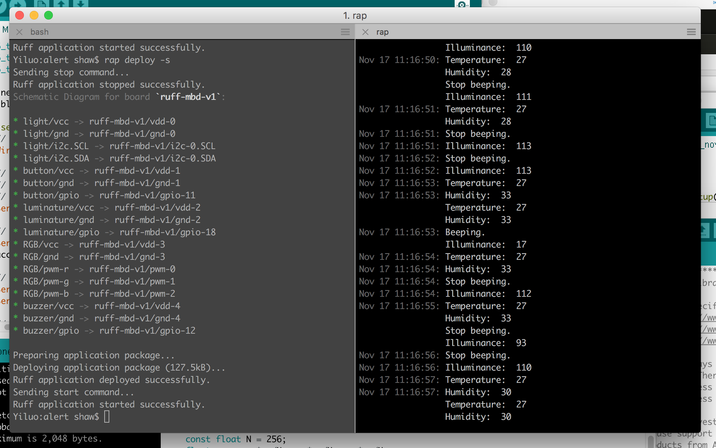
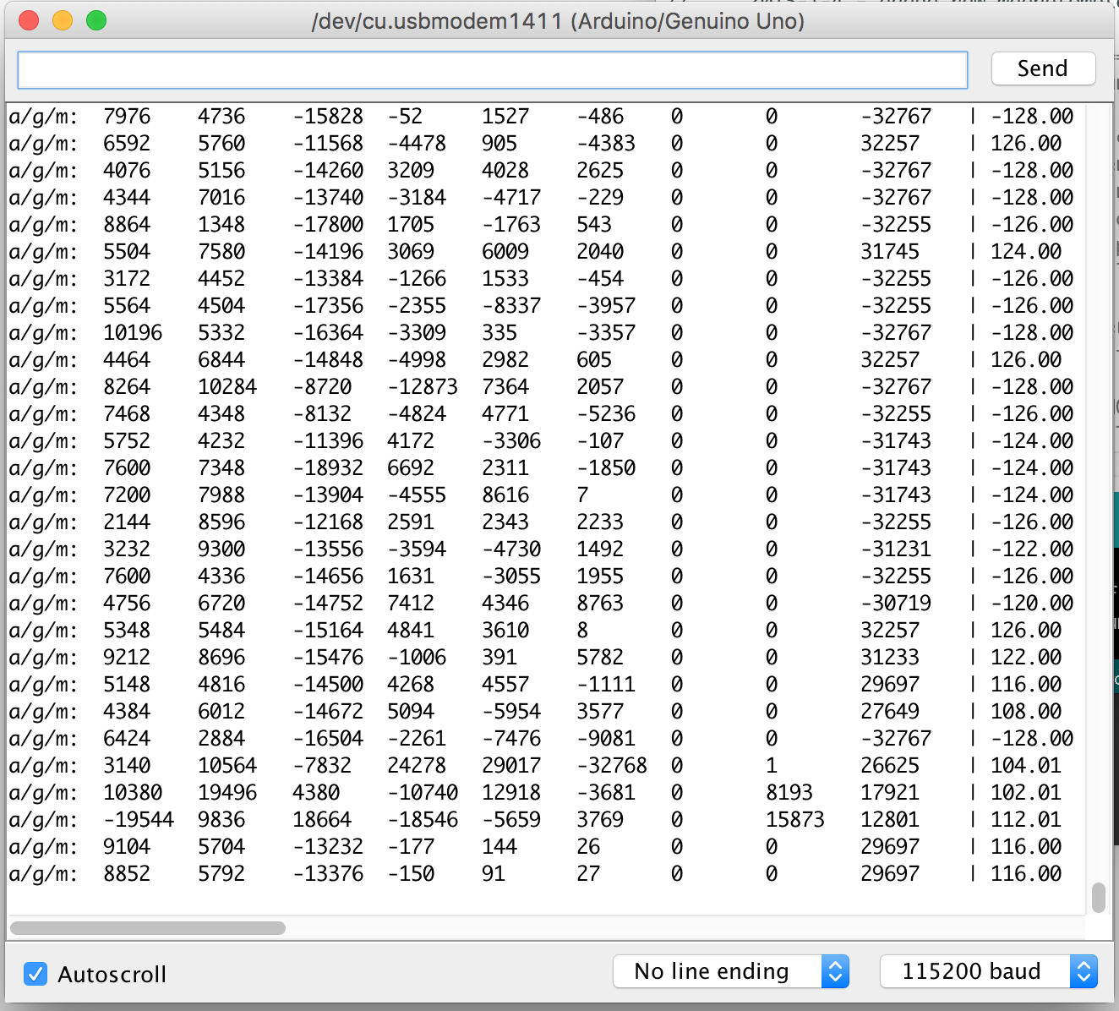

Slide 8
Android
Image Recognition
Tell the blind what is in front of him/her
Weather
To get the real-time weather
Text-to-Speech
To increase accessibility for the disabled
A data-gathering and Networking Hub

Slide 9

Technological Difficulties

Slide 10

Ruff Driver
No experience for JavaScript.
Limited amount of sensors compatible with Ruff.
Hardware drivers.
Special thanks to Ruff and its support team.

Slide 11
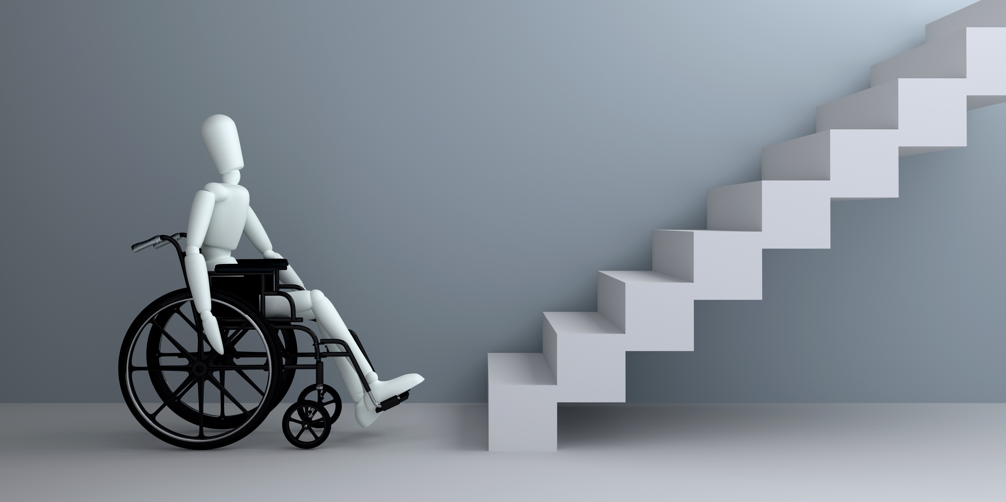
Android Text-To-Speech
Text-To-Speech is one of the most common-used accessibility options for disabled people. For their convenience, this project incorporates Android Text-To-Speech.
We attempted to use Xunfei Cloud for networked TTS engine but its documentation is so unfriendly that we have to drop it.
We moved to use Android’s system Locale TTS Engine (Pico or Samsung as the two most common-seen).

Slide 12

Location-based Weather Service
The mobile application incorporates an online Weather API, OpenWeatherMap to retrieve current weather and forecasted weather.
To make the use of the app universal, the development take special account into determining the location of the user and provide weather information accordingly.

Slide 13
Future
Communication between subsystems
Platform + a network of NGO, volunteer groups, community centers and related local governmental authorities
UI optimization → user-friendly.
Improvements after the hackathon

Slide 14
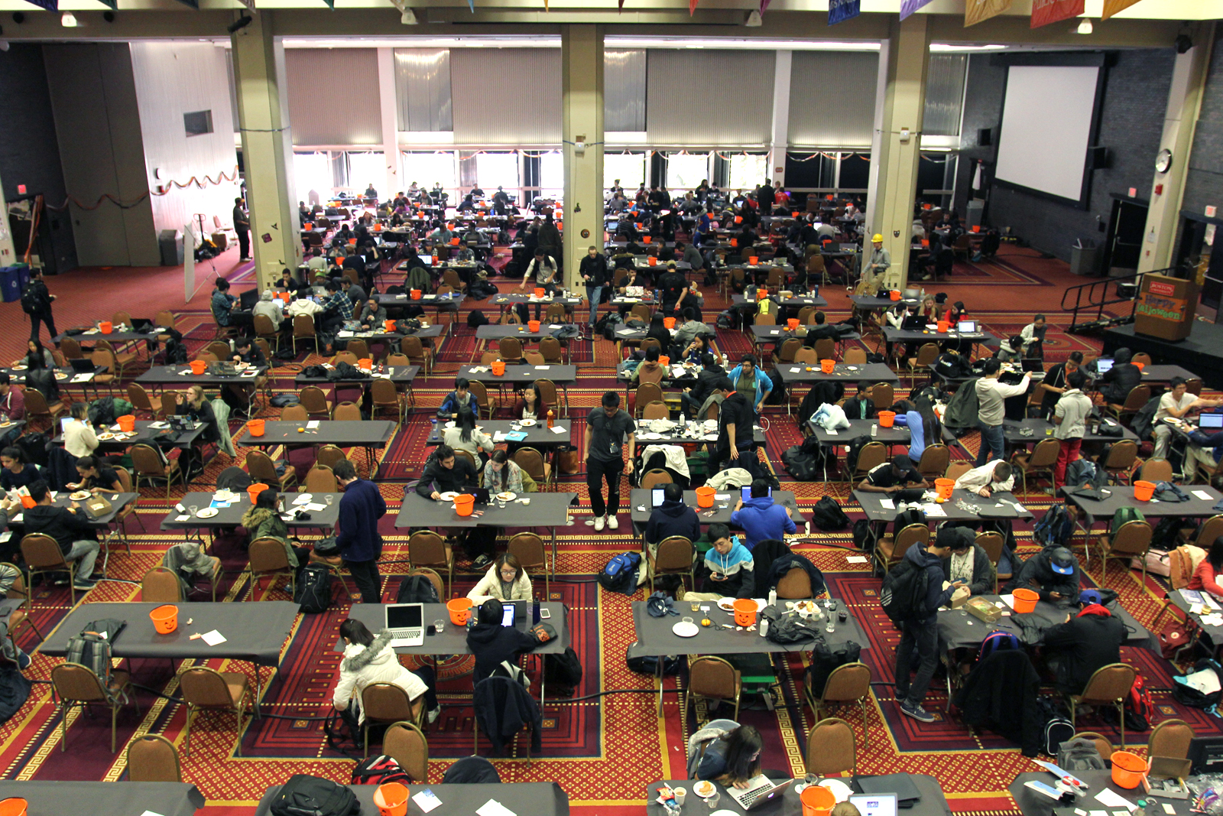
All lives matter. All lives deserve to be happy.

Slide 15
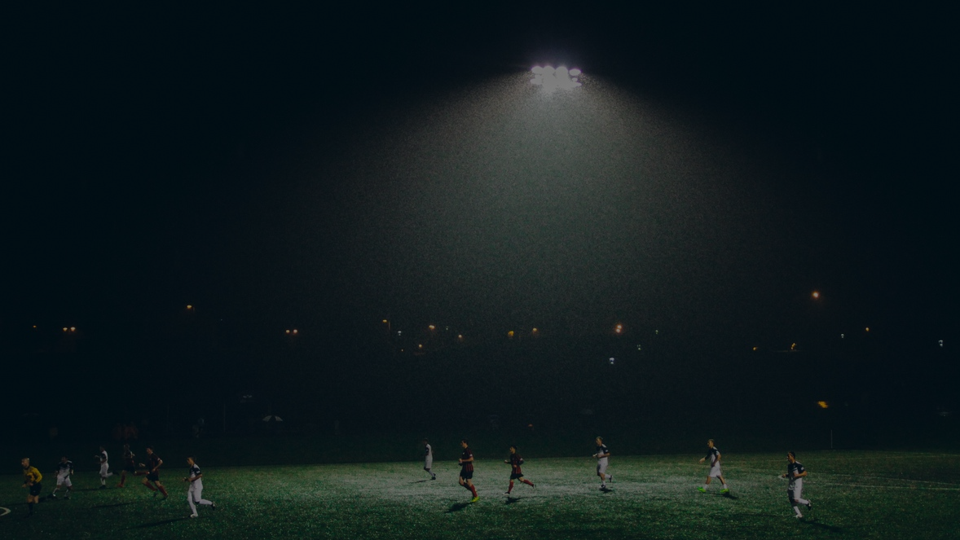
The only team with a millennium.

Slide 16
Thank you.

